Slide 1
ASSIGNMENT #2
Measures of Dispersion

Slide 2
Range
Compute the range of the following data

Slide 3
Function
function [] = Range(X)
end

Slide 4
Output of Range

Slide 5
Grouped Range
Compute the range of the following data

Slide 6
Grouped Function
function [] = Grouped_Range(X)
end

Slide 7
Output of Grouped Range

Slide 8
Coefficient of Range
Compute the Coefficient range of the following data

Slide 9
Function
function [] = Co_Range(X)
end

Slide 10
Output of coefficient Range

Slide 11
Grouped Coefficient of Range
Compute the Coefficient of range of the following data .

Slide 12
Function
function [] = Co_Range(X)
end

Slide 13
Output of coefficient Range

Slide 14
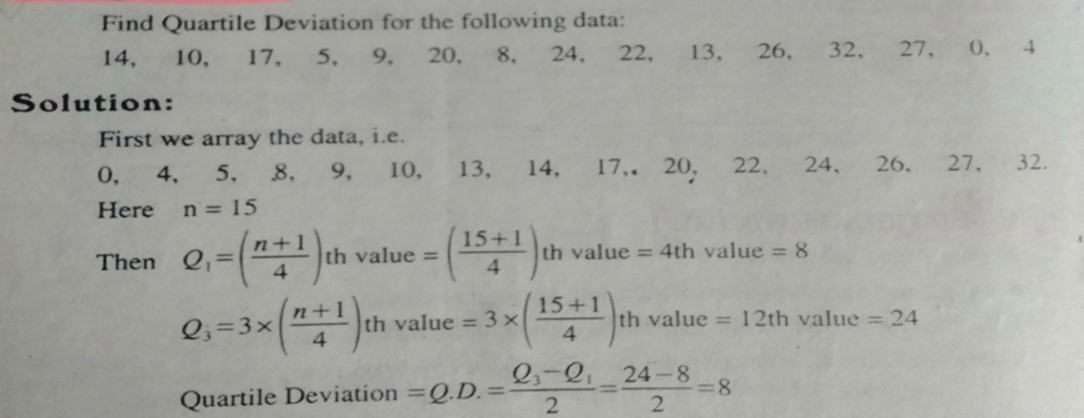
Quartile Deviation(or semi interquartile Range)
Compute the Quartile Deviation of the following data

Slide 15
Function
function [] = Q.D(X)
end

Slide 16
Output of Quartile Deviation

Slide 17
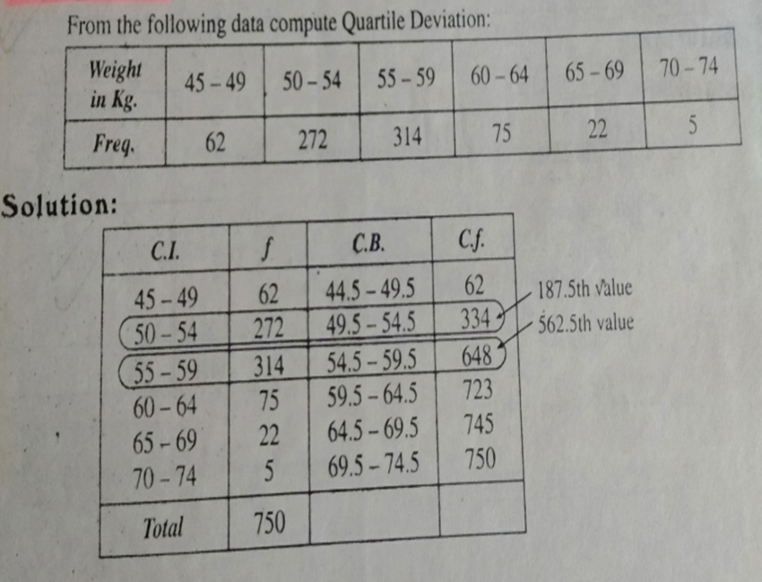
Grouped Quartile Deviation
Compute the Quartile Deviation of the following data

Slide 18
Grouped Function
function [] = Grouped_Q.D(X)
end

Slide 19
Output of Grouped Quartile Deviation

Slide 20
Coefficient of Quartile Deviation
Compute the Coefficient Quartile Deviation of the following data

Slide 21
Function
function [] = Co_Q.D (X)
end

Slide 22
Output of Co-efficient of Quartile Deviation

Slide 23
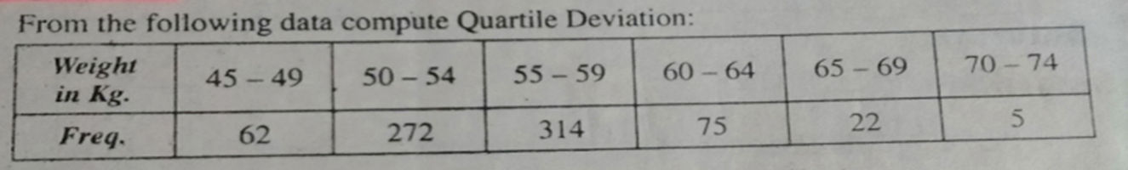
Grouped Co-efficient of Quartile Deviation
Compute the Coefficient Quartile Deviation of the following data

Slide 24
Grouped Function
function [] = Co_Q.D(X)
end

Slide 25
Output of Grouped Coefficient Quartile Deviation

